Slide 1

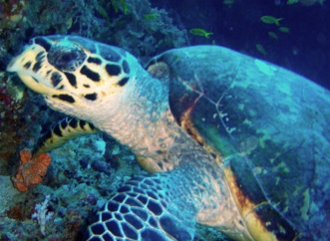
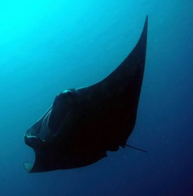
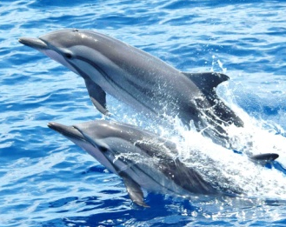
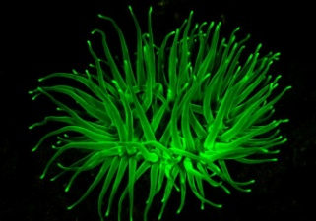
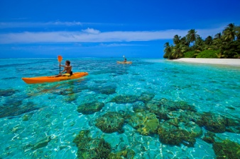
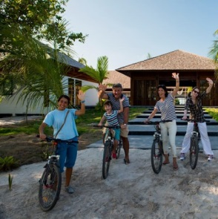
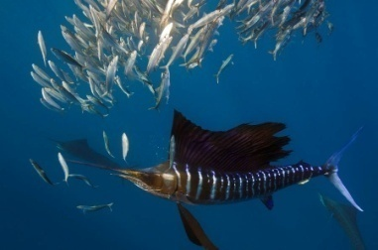
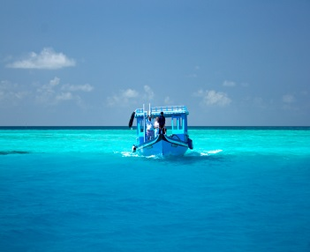

EXCURSIONS PRICE LIST
SNORKELING AND EXPLORATION
Snorkelling by dhoni
minimum 6 pax | USD 23/- per pax
Dolphin monitoring trip by dhoni
minimum 6 pax | USD 40/- per pax
Manta monitoring trip by dhoni
minimum 6 pax | USD 40/- per pax
Night-fluoro snorkeLling by dhoni
minimum 4 pax | USD 45/- per pax
Desert island trip
minimum 6 pax | USD 45/- per pax
Sunset romantic cruise
2 pax | USD 73/- per pax
Environmental and cultural bicycle tour
minimum 4 pax | USD 20/- per pax
Forest walk
minimum 4 pax | USD 13/- per pax
Utheem sultan palace guided visit
minimum 6 pax | USD 34/- per pax
Environmental lab for kids
minimum 4 pax | USD 17/- per pax
BIG GAME FISHING (CATCH & RELEASE )
Trolling including fishing rod (max 2 lines)
3 hours | USD 300/- for boat
4 hours | USD 360/- for boat
extra hour if more than 4 hours | USD 70/- per hour
DHONI RENTAL
Dhoni Rental (Private excursion)
1 hour | USD 125/- for boat
2 hours | USD 200/- for boat
3 hours | USD 270/- for boat
half day (4 hours) | USD 325/- for boat
full day (8 hours) | USD 505/- for boat
extra hour if more than 4 hours | USD 50/ - for boat
  Private excursions can be organized on request.
  All prices are in USD, 12% GST included. 10% service charge on net price and 12% GST on service charge not included.
  All published prices are subject to change without prior notice.
Hanimadhoo – Haa Dhaalu Atoll – Rep. of Maldives
www.thebarefoot.com

